Slide 1


Shanghai | Changsha | Guangzhou | Da Nang | Munich

Slide 2



AUTOSAR
OPERATING
SYSTEM

Slide 3

AUTOSAR OPERATING SYSTEM
I. OS Introduction and Overview.
II. Autosar OS Application
III. Implement Autosar OS using Davinci Tool

Slide 4
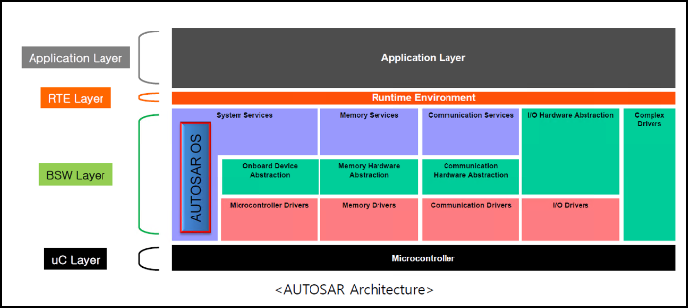
I. OS Introduction and Overview.
1. OS introduction
OS is located in Service layer which is a part of the Base Software layer.
It manages the scheduling of tasks and events, the data flow between different tasks and provides features for monitoring and error handling.
AUTOSAR OS is an evolution of OSEK OS

Slide 5
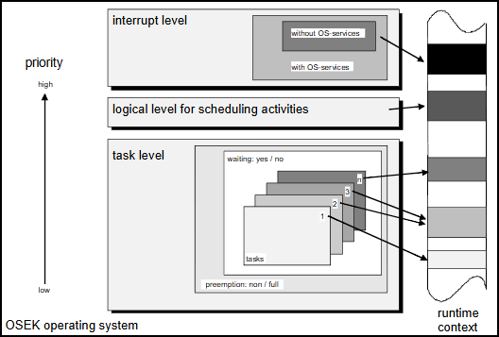
I. OS Introduction and Overview.
2. OS Overview
OSEK defines three processing levels: • Interrupt level • Logical level for scheduler • Task level
Notes:
Within the task level tasks are scheduled (non, full or mixed preemptive scheduling) according to their user assigned priority. The run time context is occupied at the beginning of execution time and is released again once the task is finished.

Slide 6
I. OS Introduction and Overview.
2. OS Overview
Task
Scheduler
Event
OS Components
Stack
ISR
Counter & Alarm
Resource Management

Slide 7
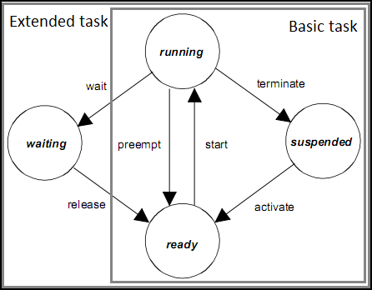
I. OS Introduction and Overview.
2. OS Overview
2.1 Task
A task is a basic unit of a program controlled by the OS (a function in the C language)
Tasks that are executed periodically, Tasks that are executed when interrupts/alarm occur., etc...
There are 2 types of Task: Basic Task and Extended Task
Basic Task: The Task has 3 states(Suspended-Ready -Running)
Basic Task: The Task has 4 states(Suspended-Ready –Running-Waiting)
The state machine of Task
Notes:
Running->ready: If the normal operation of the current task does not end, and there is a higher priority TASK or ISR request, the OS will interrupt the current task, press the TASK to the stack, and the TASK will return to the Ready state
The waiting state allows the processor to be freed and to be reassigned to a lower-priority task without the need to terminate the Extended Task.

Slide 8
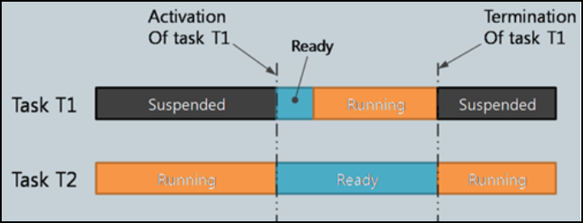
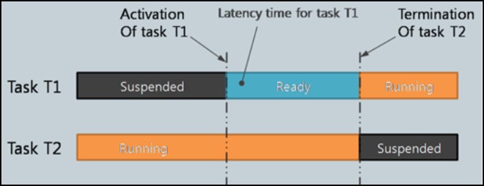
I. OS Introduction and Overview.
2. OS Overview
2.2 Scheduler
Scheduler is a algorithm that manages the status and adjust the execution order so that multiple task can occupy a single processor.
The scheduler is responsible to manage ready tasks and determine which task should be running next.
Scheduling policy for Basic Task:
Full-Preemptive
Non-Preemptive

Slide 9
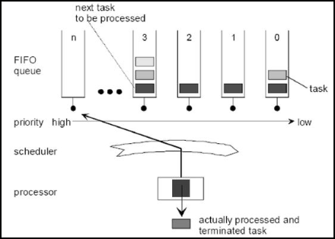
I. OS Introduction and Overview.
2. OS Overview
2.2 Scheduler
Multi-tasking requires scheduling to determine which tasks in the ready queue to allocate to CPU.
If there are multiple tasks of the same priority, the first task in the queued (oldest) ready state is selected.

Slide 10
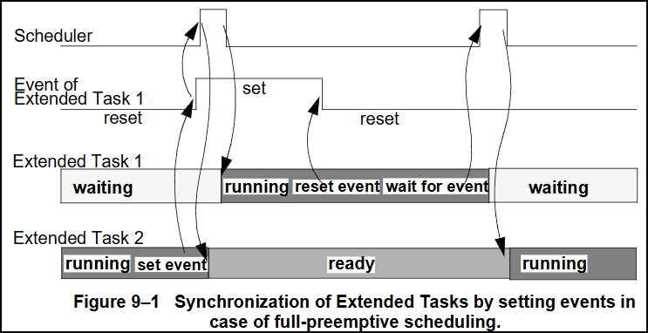
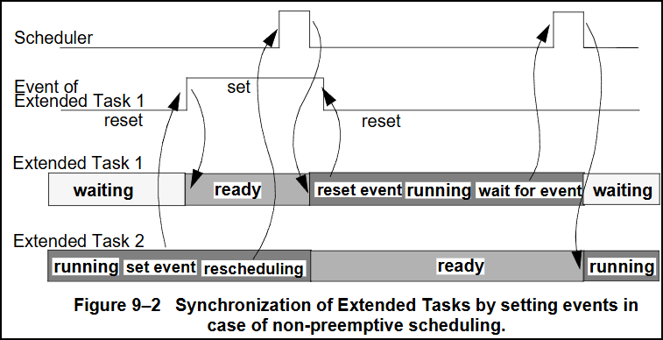
I. OS Introduction and Overview.
2. OS Overview
2.3 Event
Events are an exclusive signal which is assigned to an Extended Task. For the scheduler, events are the criteria for the transition of Extended Tasks from the waiting state into the ready state.
Extended Tasks are in the waiting state, if an event for which the task is waiting has not occurred.
If an extended Tasks tries to wait for an event and this event has already occurred, the task remains in the running state
Scheduling policy for Extended task:
Full-Preemptive
Non-Preemptive
Notes:
Full Preemptive: Extended Task 1 (with higher priority) waits for an event. Extended Task 2 sets this event for Extended Task 1. The scheduler is activated. Subsequently, Task 1 is transferred from the waiting state into the ready state. Due to the higher priority of Tasks 1 this results in a task switch, Task 2 being preempted by Task 1. Task 1 resets the event. Thereafter Task 1 waits for this event again and the scheduler continues execution of Task 2.
Non Preemptive: Extended Task 1 (with higher priority) waits for an event. Extended Task 2 sets this event for Extended Task 1. Task 1 is transferred to ready but still not running, it will wait for Task 2 finish and the scheduler will switch task 1 to running. Task 1 reset event and continue running until wait for the next event occur. T1 will change to the Waiting state and the scheduler will switch Task 2 to running

Slide 11
I. OS Introduction and Overview.
2. OS Overview
2.4 Task Stack
During run-time every task has its own stack. The stack is either dynamically assigned to a task during its activation or statically allocated for a task during system initialization.
Similar to interrupts, when a high-priority task preempts a low-priority task, the contents that need to be saved include register sets, local variables, and return addresses.
AUTOSAR OS usually sets a separate stack area for each task (usually consuming RAM).
Notes:
Stack Monitoring: The Operating System module shall provide a stack monitoring which detects possible stack faults of Task(s)/Category 2 ISR(s).
Stack monitoring will identify where a Task or ISR has exceeded a specified stack usage at context switch time.

Slide 12
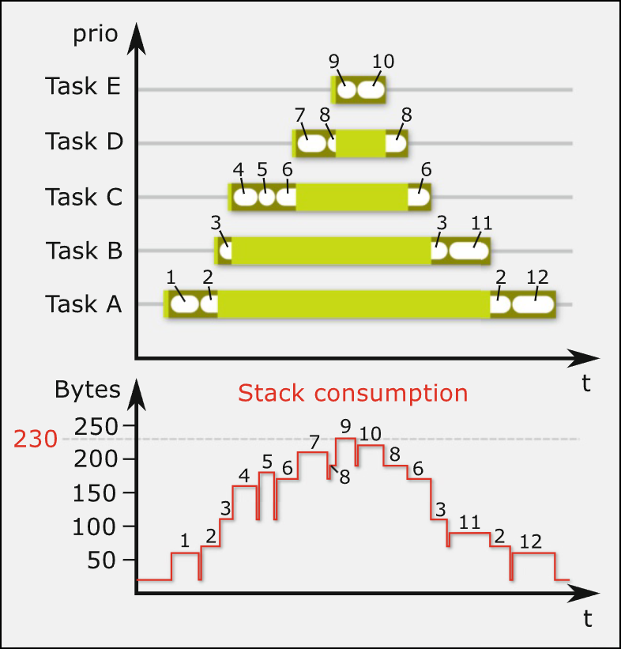
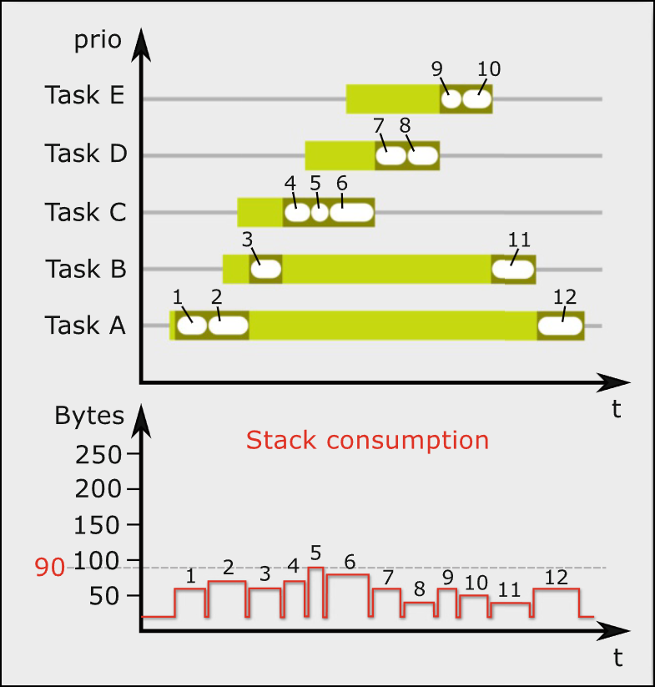
I. OS Introduction and Overview.
2. OS Overview
2.4 Task Stack
Full-Preemptive Task Stack
Non Preemptive Task Stack
Notes:
Stack Monitoring: The Operating System module shall provide a stack monitoring which detects possible stack faults of Task(s)/Category 2 ISR(s).
Stack monitoring will identify where a Task or ISR has exceeded a specified stack usage at context switch time.

Slide 13
I. OS Introduction and Overview.
2. OS Overview
2.5 Interrupt Service Routine(ISR)
An Interrupt Service Routine (ISR) is a routine which is invoked from an interrupt source, such as
a timer or an external hardware event.
ISRs have higher priority than all tasks and the scheduler.
Addresses of ISRs is pointed in the vector table.
• ISRs can communicate with tasks by the following means:
- ISR can activate a task. - ISR can send a state or an event message to a task. - ISR can trigger a counter.

Slide 14
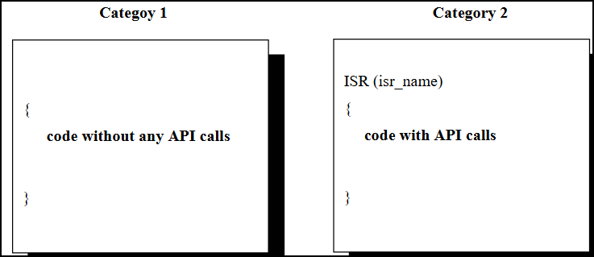
I. OS Introduction and Overview.
2. OS Overview
2.5 Interrupt Service Routine(ISR)
• ISR Categories
- ISR category 1: The ISR does not use an operating system service8. After the ISR is finished, processing continues exactly at the instruction where the interrupt has occurred, i.e. the interrupt has no influence on task management. ISRs of this category have the least overhead.
- ISR category 2: The OSEK operating system provides an ISR-frame to prepare a run-time environment for a dedicated user routine. During system generation the user routine is assigned to the interrupt.

Slide 15
I. OS Introduction and Overview.
2. OS Overview
2.5 Interrupt Service Routine(ISR)
• ISR Categories
- ISR category 1: The ISR does not use an operating system service8. After the ISR is finished, processing continues exactly at the instruction where the interrupt has occurred, i.e. the interrupt has no influence on task management. ISRs of this category have the least overhead.
- ISR category 2: The OSEK operating system provides an ISR-frame to prepare a run-time environment for a dedicated user routine. During system generation the user routine is assigned to the interrupt.

Slide 16
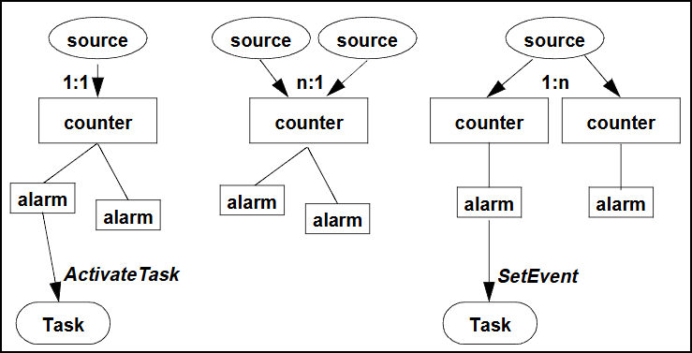
I. OS Introduction and Overview.
2. OS Overview
2.6 Counter and Alarm
Alarm
The alarm management allows the user link task activation or event setting to a certain counter value.
Ex:
- Activate a certain task, after the counter has been advanced 60 times
- Set a certain event, after the counter has reached a value of 90

Slide 17
I. OS Introduction and Overview.
2. OS Overview
2. Counter and Alarm
Counter
- Counter is used for identifying the activation time of Task/ Event in OS.
- Counter is linked to hardware timer(GPT).
- An increment of the HW-counter by one shall be called “tick”.

Slide 18
I. OS Introduction and Overview.
2. OS Overview
2.7 Resource Management
The resource management is used to co-ordinate concurrent accesses of several tasks with different priorities to shared resources, e.g. management entities (scheduler), program sequences, memory or hardware areas.
Resource management ensures that - Two tasks cannot occupy the same resource at the same time. - Priority inversion can not occur. - Deadlocks do not occur by use of these resources. - Access to resources never results in a waiting state

Slide 19
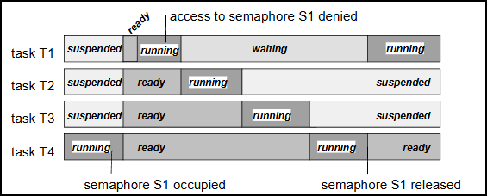
I. OS Introduction and Overview.
2. OS Overview
2.7 Resource Management
2.7.1 Priority inversion
Priority inversion: Lower-priority task delays the execution of higher-priority task. It is a typical problem of common synchronization mechanisms.
Notes:
illustrates sequencing of the common access of two tasks to a semaphore (in a full preemptive system, task T1 has the highest priority) Task T4 which has a low priority, occupies the semaphore S1. T1 preempts T4 and requests the same semaphore. As the semaphore S1 is already occupied,
T1 enters the waiting state. Now the low-priority T4 is interrupted and preempted by tasks with a priority between those of T1 and T4. T1 can only be executed after all lower-priority tasks have been terminated, and the semaphore S1 has been released again.
Although T2 and T3 do not use semaphore S1, they delay T1 with their runtime.

Slide 20
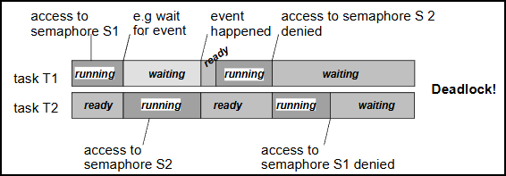
I. OS Introduction and Overview.
2. OS Overview
2.7 Resource Management
2.7.2 Deadlocks
Deadlocks: Another typical problem of common synchronization mechanisms, such as the use of semaphores, is the problem of deadlocks. In this case deadlock means the impossibility of task execution due to infinite waiting for mutually locked resources.
Notes:
Task T1 occupies the semaphore S1 and subsequently cannot continue running, e.g. because it is waiting for an event.
Thus, the lower-priority task T2 is transferred into the running state. It occupies the semaphore S2.
If T1 gets ready again and tries to occupy semaphore S2, it enters the waiting state again.
If now T2 tries to occupy semaphore S1, this results in a deadlock.

Slide 21
I. OS Introduction and Overview.
2. OS Overview
2.7 Resource Management
2.7.3 Priority Ceiling Protocol
At the system generation, to each resource its own ceiling priority is statically assigned. The ceiling priority shall be set at least to the highest priority of all tasks that access a resource or any of the resources linked to this resource. The ceiling priority shall be lower than the lowest priority of all tasks that do not access the resource, and which have priorities higher than the highest priority of all tasks that access the resource.
If a task requires a resource, and its current priority is lower than the ceiling priority of the resource, the priority of the task is raised to the ceiling priority of the resource
If the task releases the resource, the priority of this task is reset to the priority which was dynamically assigned before requiring that resource.
Notes:
Task T1 occupies the semaphore S1 and subsequently cannot continue running, e.g. because it is waiting for an event.
Thus, the lower-priority task T2 is transferred into the running state. It occupies the semaphore S2.
If T1 gets ready again and tries to occupy semaphore S2, it enters the waiting state again.
If now T2 tries to occupy semaphore S1, this results in a deadlock.

Slide 22
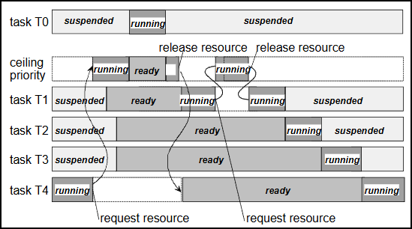
I. OS Introduction and Overview.
2. OS Overview
2.7 Resource Management
2.7.3 Priority Ceiling Protocol
Resource assignment with priority ceiling between preemptable tasks

Slide 23
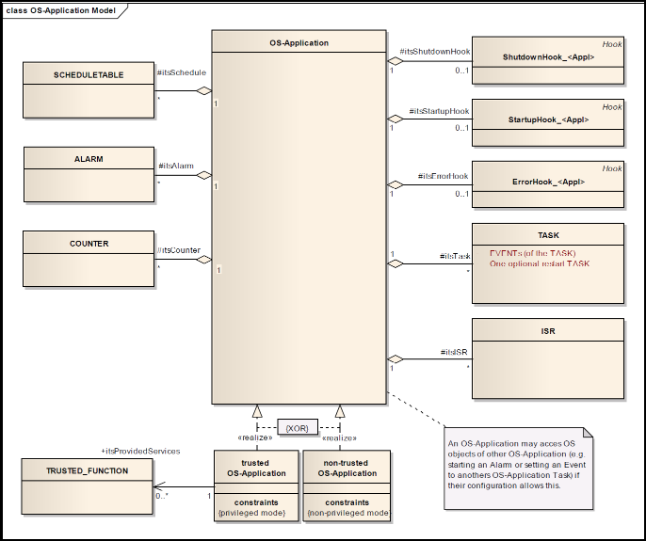
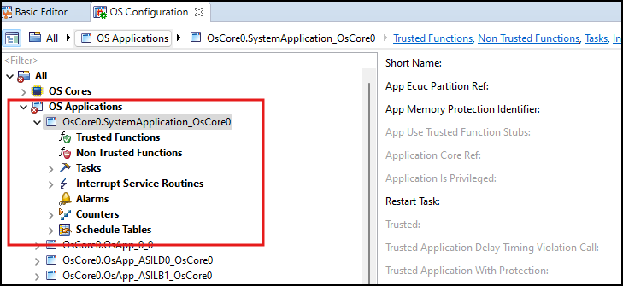
II. AUTOSAR OS Application.
Autosar OS Application Components

Slide 24
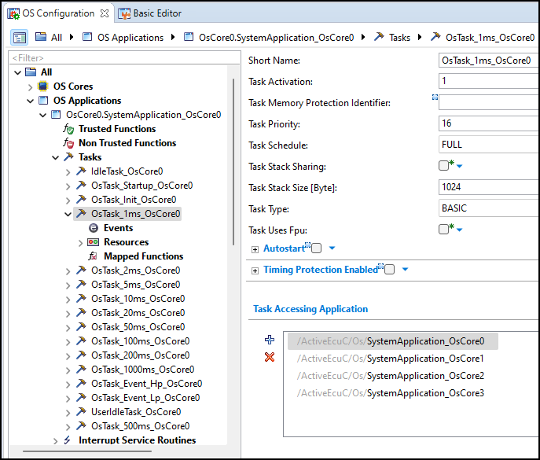
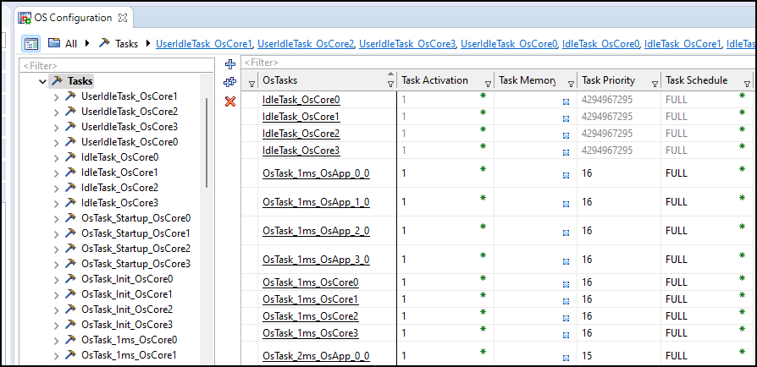
II. AUTOSAR OS Application.
1. Autosar OS Task
Task is configured in Davinci Configurator.
Notes:
Task activation: This attribute defines the maximum number of queued activation requests for the task. A value equal to "1" means that at any time only a single activation is permitted for this task. Note that the value must be a natural number starting at 1.

Slide 25
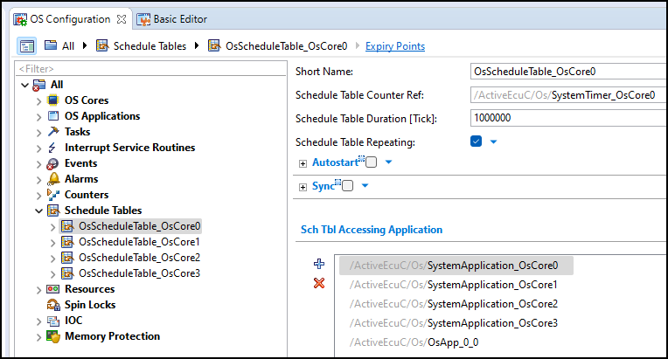
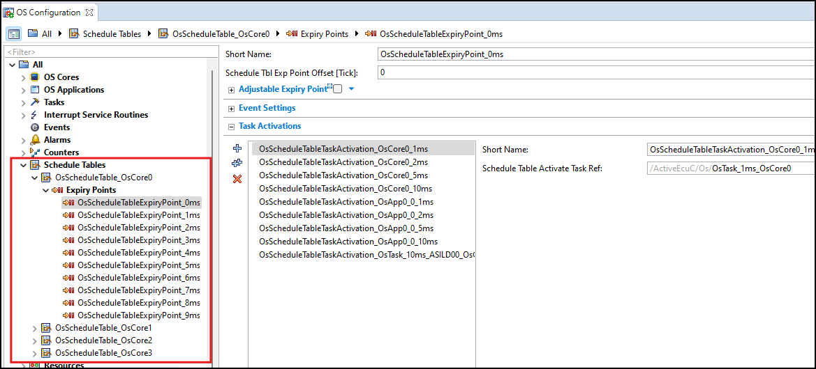
II. AUTOSAR OS Application.
2. Autosar OS Schedule Table
Schedule Table is used to active Tasks and set Event.
Each Schedule Table contains the Expiry Points.
Each Expiry Point contain the Tasks which need to be activated.
Notes:
Task activation: This attribute defines the maximum number of queued activation requests for the task. A value equal to "1" means that at any time only a single activation is permitted for this task. Note that the value must be a natural number starting at 1.

Slide 26
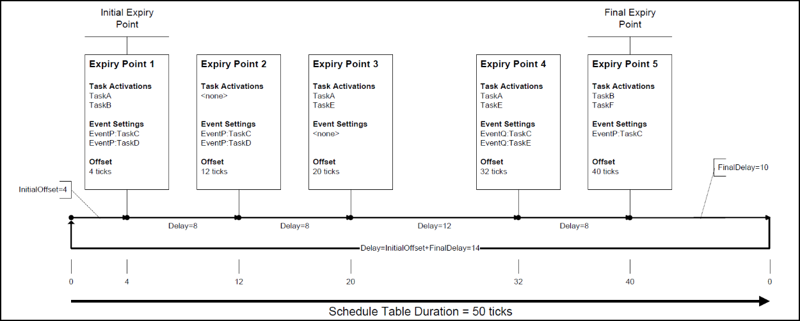
II. AUTOSAR OS Application.
2. Autosar OS Schedule Table
A Schedule Table shall have at least one expiry point.
An expiry point shall activate at least one Task OR set at least one event.
Each expiry point on a given Schedule Table shall have a unique offset.

Slide 27
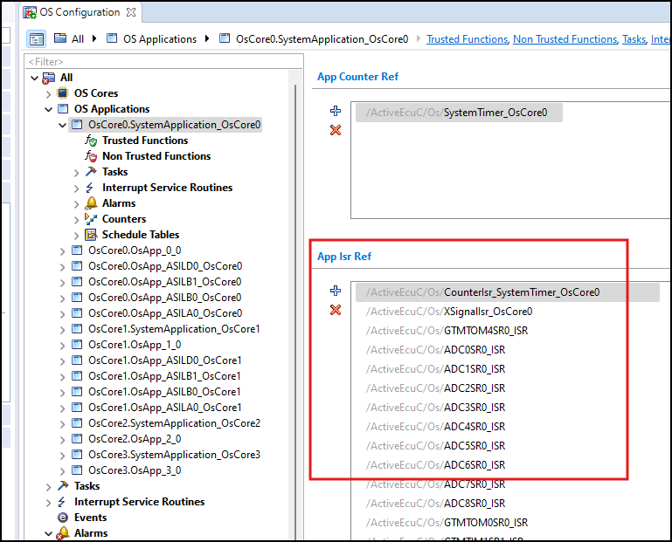
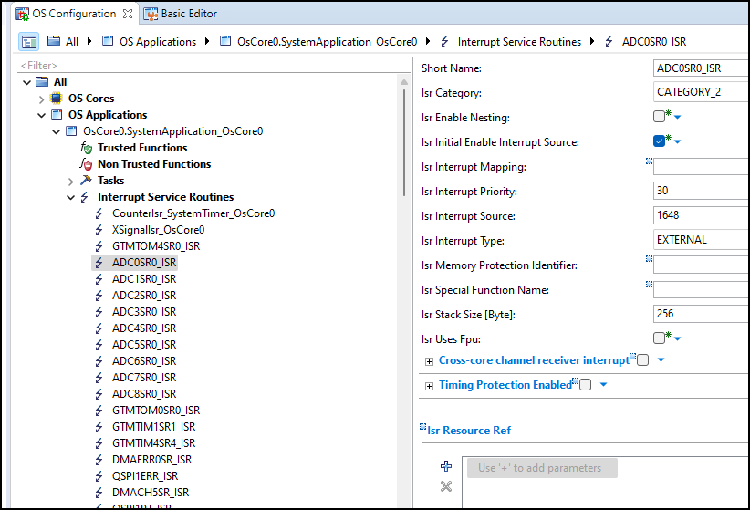
II. AUTOSAR OS Application.
3. Autosar OS ISR
ISR configuration

Slide 28
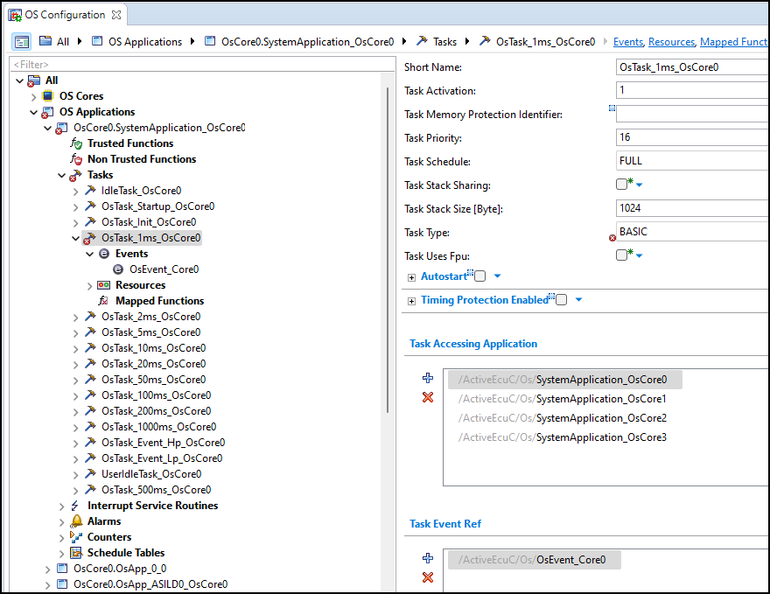
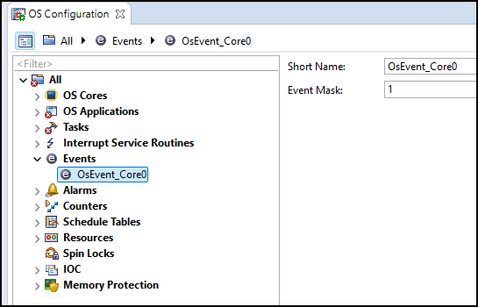
II. AUTOSAR OS Application.
4. Autosar OS Event
Event configuration

Slide 29
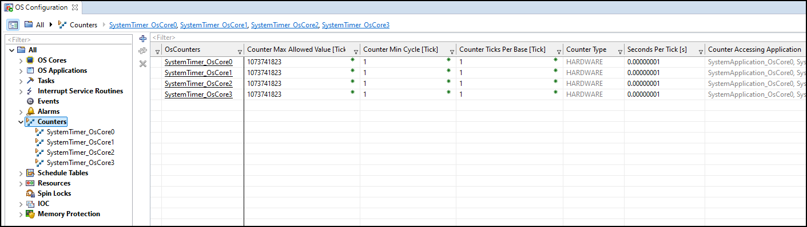
II. AUTOSAR OS Application.
5. Autosar OS Counter
Counter configuration

Slide 30
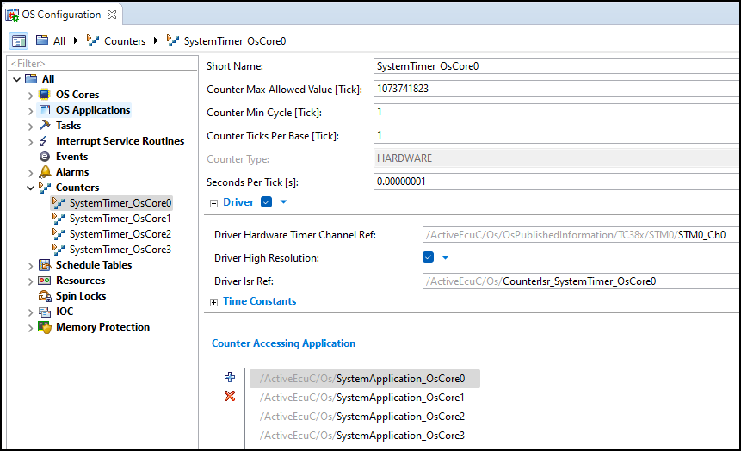
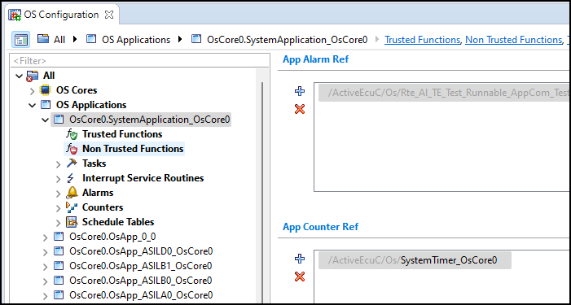
II. AUTOSAR OS Application.
5. Autosar OS Counter
Counter configuration
Seconds Per Tick [s]: Time of one counter tick in seconds.
Seconds Per Tick [s] = 1/f(system clock)
Counter ticks Per Base [Tick]:
- The TICKSPERBASE attribute specifies the number of ticks required to reach a counter specific unit.

Slide 31
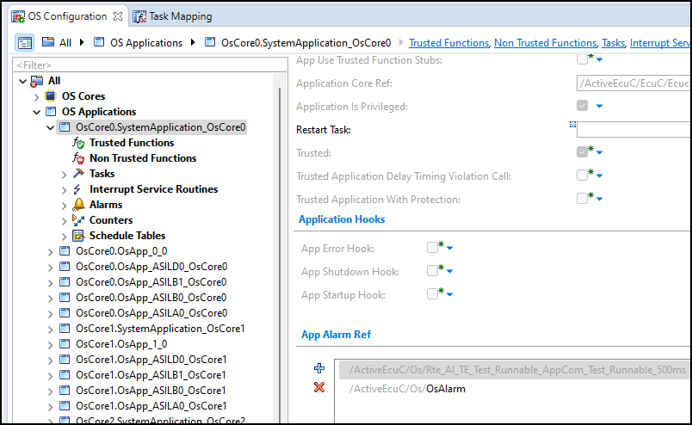
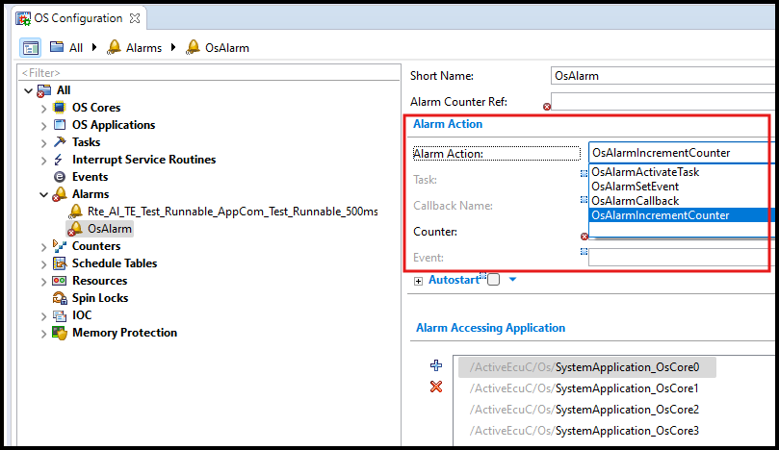
II. AUTOSAR OS Application.
6. Autosar OS Alarm
Alarm configuration

Slide 32
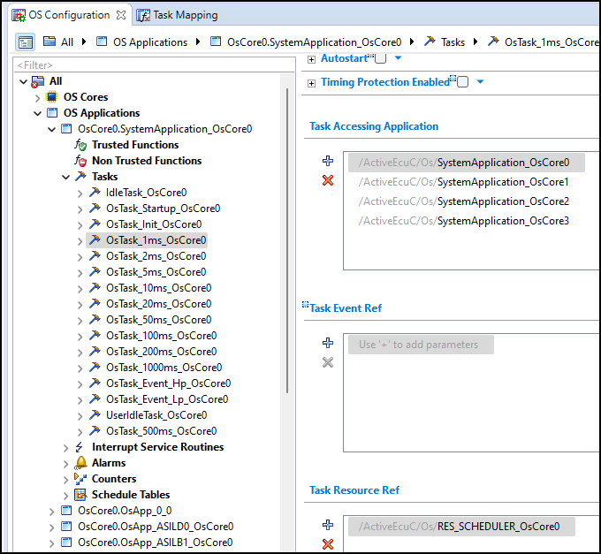
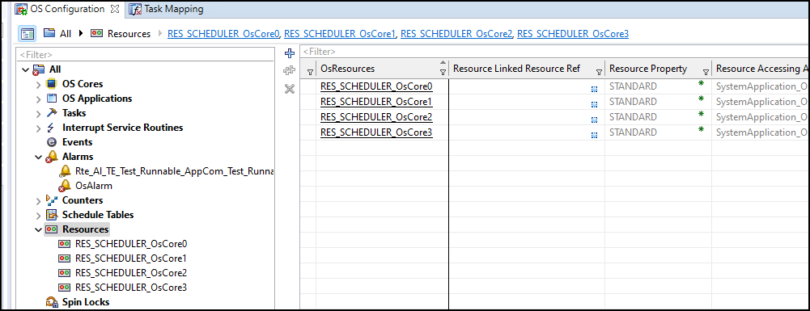
II. AUTOSAR OS Application.
7. Autosar OS Resource Management
Resource Management configuration

Slide 33
III. Implement Autosar OS using Davinci Tool
Practice Task: Create a runnable function run in Task 500ms and verify the period time of Task.

Slide 34
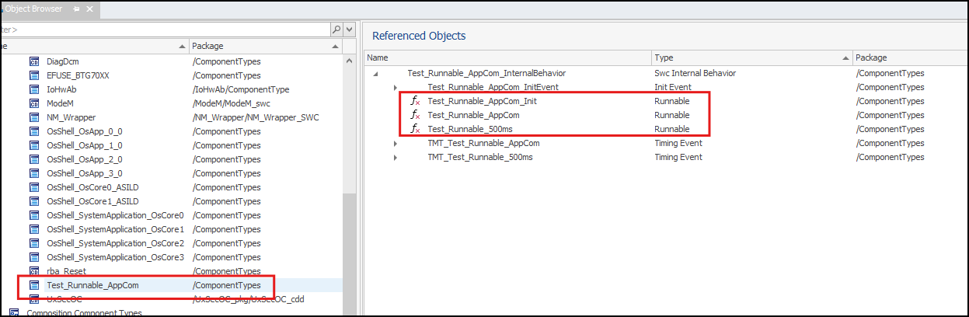
III. Implement Autosar OS using Davinci Tool
1. Runnable Function Creation
Using Davinci Developer Tool to create a Runnable function.

Slide 35
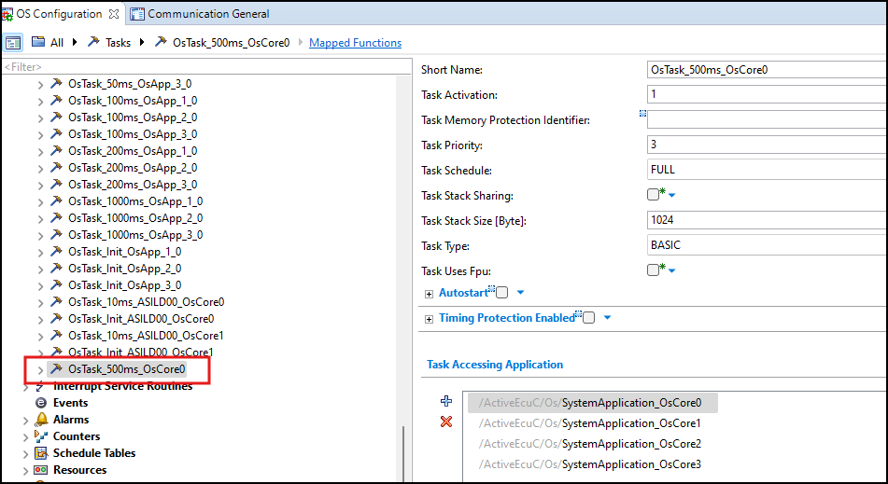
III. Implement Autosar OS using Davinci Tool
2. Task 500ms Creation
Using Davinci Configuarion Tool to create Task 500ms

Slide 36
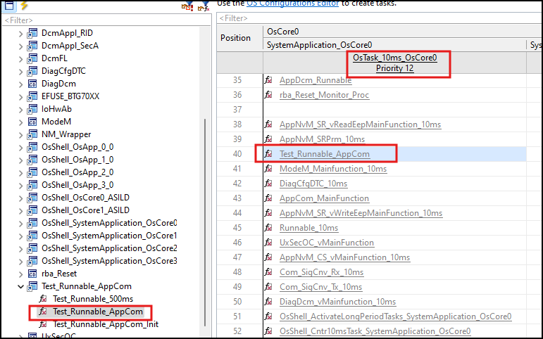
III. Implement Autosar OS using Davinci Tool
3. Mapping Runnable function to Task
Open Task Mapping section in Davinci Configuarion Tool mapping runnable functions to Task.
Test_Runnable_AppCom runnable function will run in Task 10ms

Slide 37
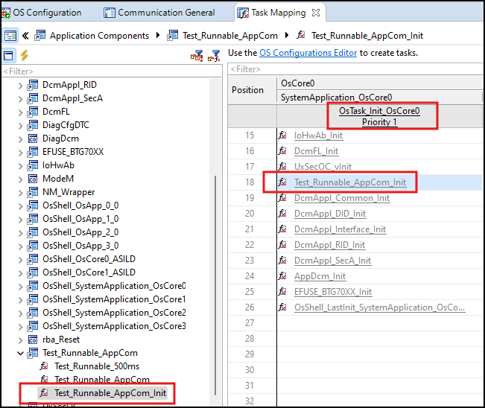
III. Implement Autosar OS using Davinci Tool
3. Mapping Runnable function to Task
Open Task Mapping section in Davinci Configuarion Tool mapping runnable functions to Task.
Test_Runnable_AppCom_Init runnable function will run in Task Init

Slide 38
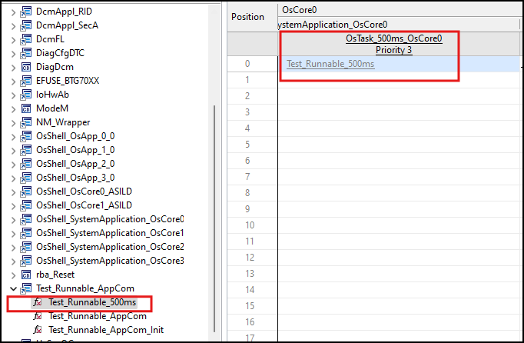
III. Implement Autosar OS using Davinci Tool
3. Mapping Runnable function to Task
Open Task Mapping section in Davinci Configuarion Tool mapping runnable functions to Task.
Test_Runnable_500ms runnable function will run in Task 500ms

Slide 39
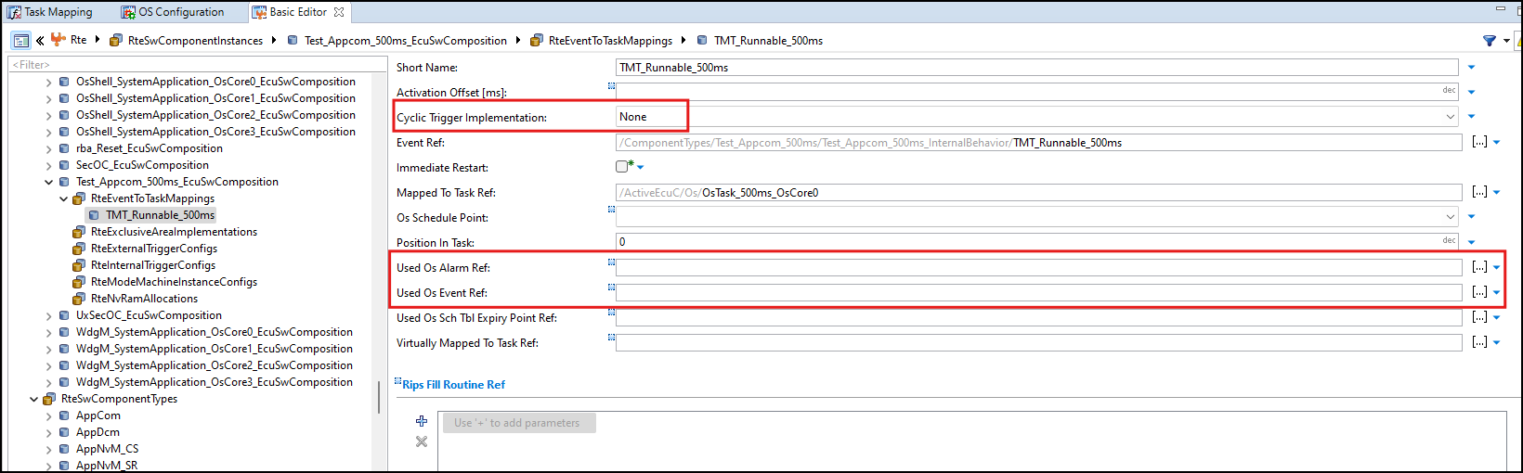
III. Implement Autosar OS using Davinci Tool
3. Mapping Runnable function to Task
Open the container below:
Set Cyclic Trigger Implementation is None.
Set Alarm and Event is Blank.

Slide 40
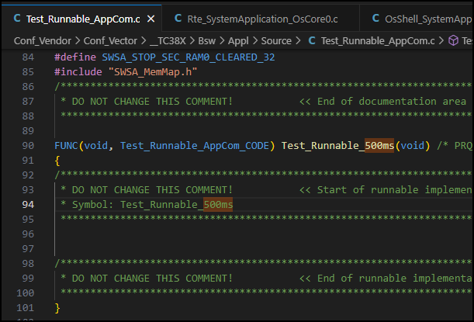
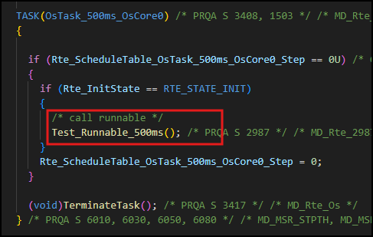
III. Implement Autosar OS using Davinci Tool
4. Generate code and coding.
After finishing configuration, go to step generate code and template for Runnable and Task.
Task 500ms will call Test_Runnable_500ms like configuration in TaskMapping.

Slide 41
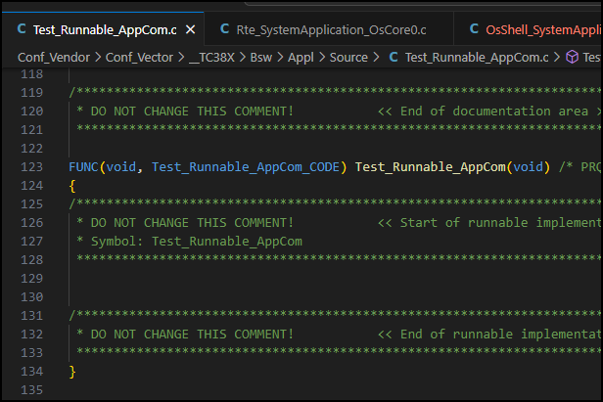
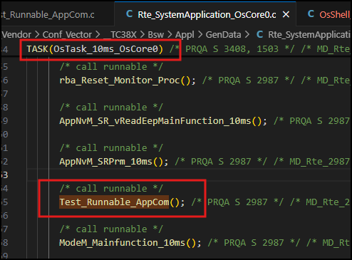
III. Implement Autosar OS using Davinci Tool
4. Generate code and coding.
Task 10ms will call Test_Runnable_AppCom like configuration in TaskMapping.

Slide 42
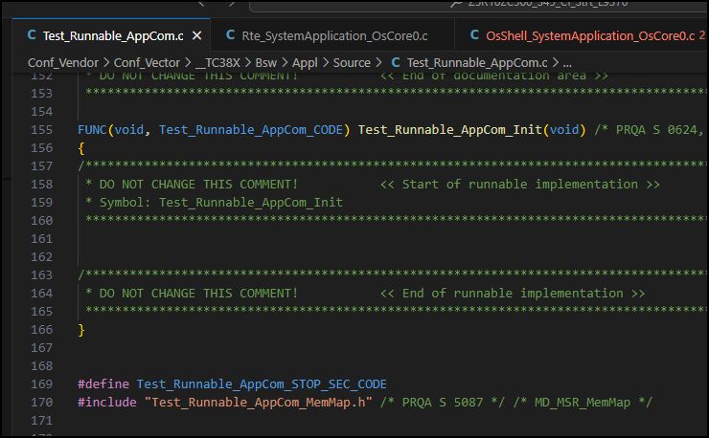
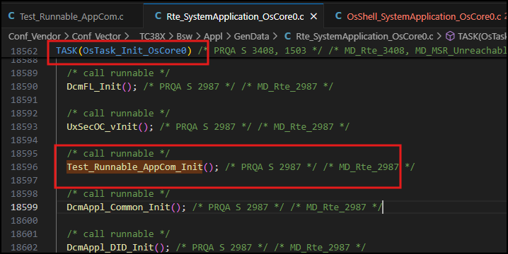
III. Implement Autosar OS using Davinci Tool
4. Generate code and coding.
Task Init will call Test_Runnable_AppCom_Init like configuration in TaskMapping.

Slide 43
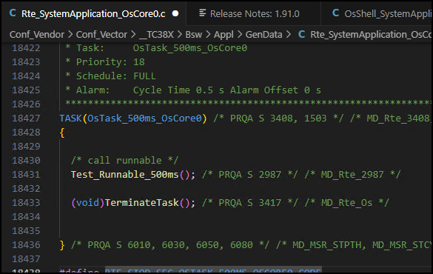
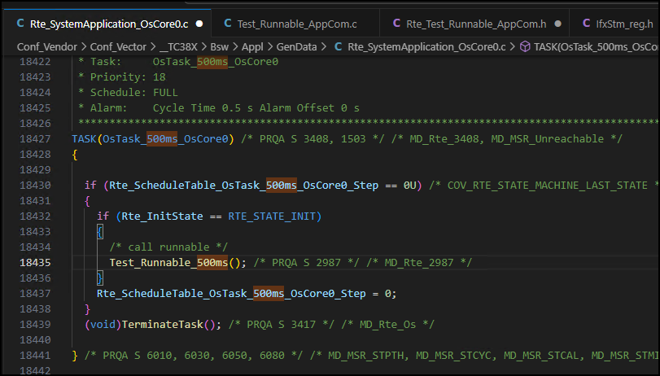
III. Implement Autosar OS using Davinci Tool
4. Generate code and coding.
Task definition
Modify Task to set the task run when Rte Init Memory and Rte Start finish.

Slide 44
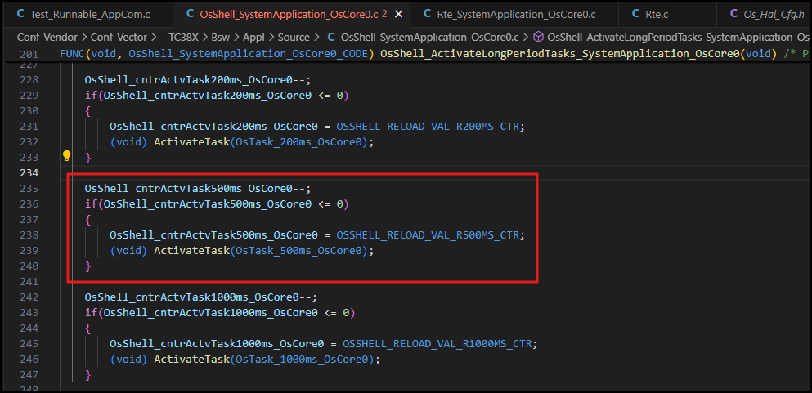
III. Implement Autosar OS using Davinci Tool
4. Generate code and coding.
Task Activation.

Slide 45
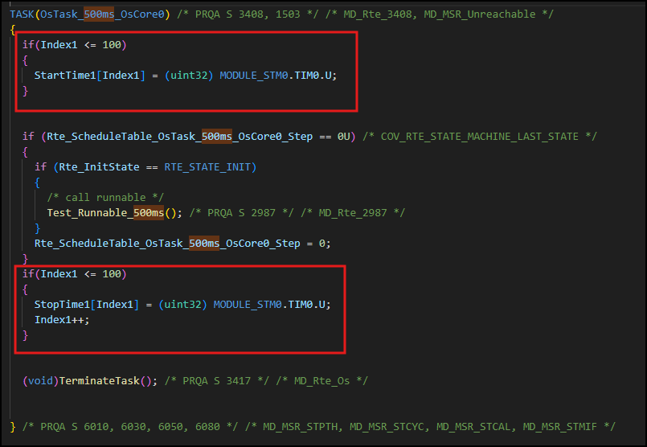
III. Implement Autosar OS using Davinci Tool
5. Measurement.
Verify the Task will run every 500ms.

Slide 46
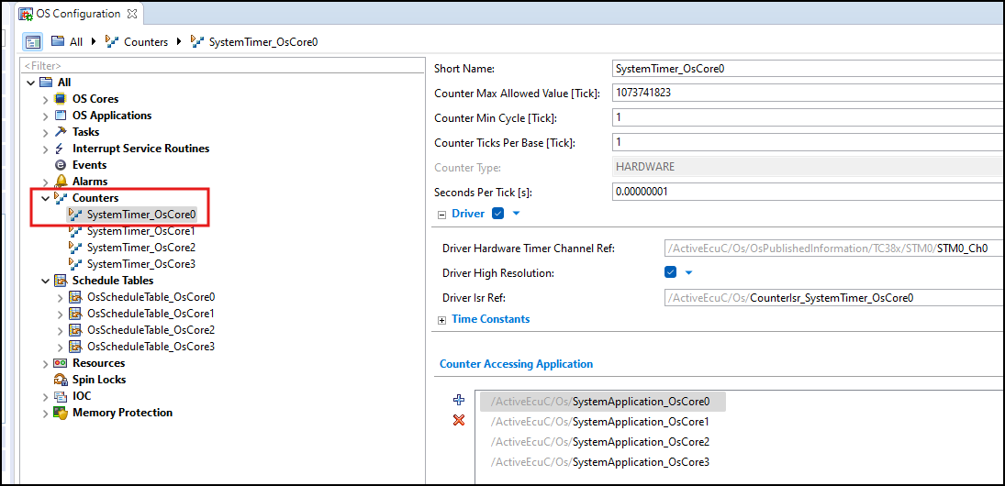

III. Implement Autosar OS using Davinci Tool
5. Measurement.
Data Collection
Fomulus:
Seconds Per Tick [s]: 0.00000001
-> 1 tick = 0.00000001 s = 0.00001ms
Counter tick per Base = 1
Period Time = (StatTime[1] - StartTime[0])*0.00001*1 (ms)

Slide 47




